Slide 1
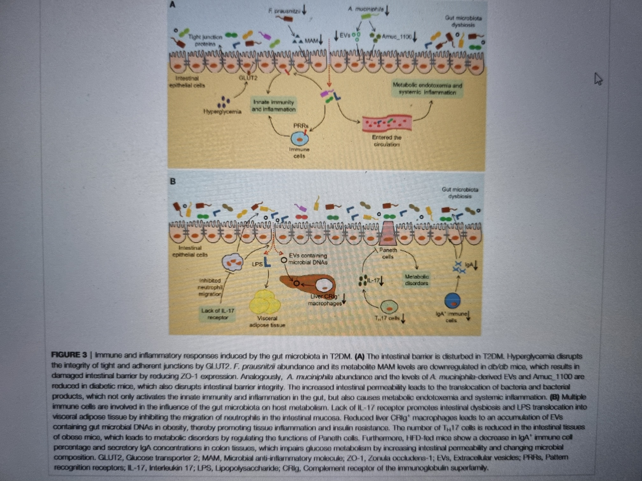

Slide 2
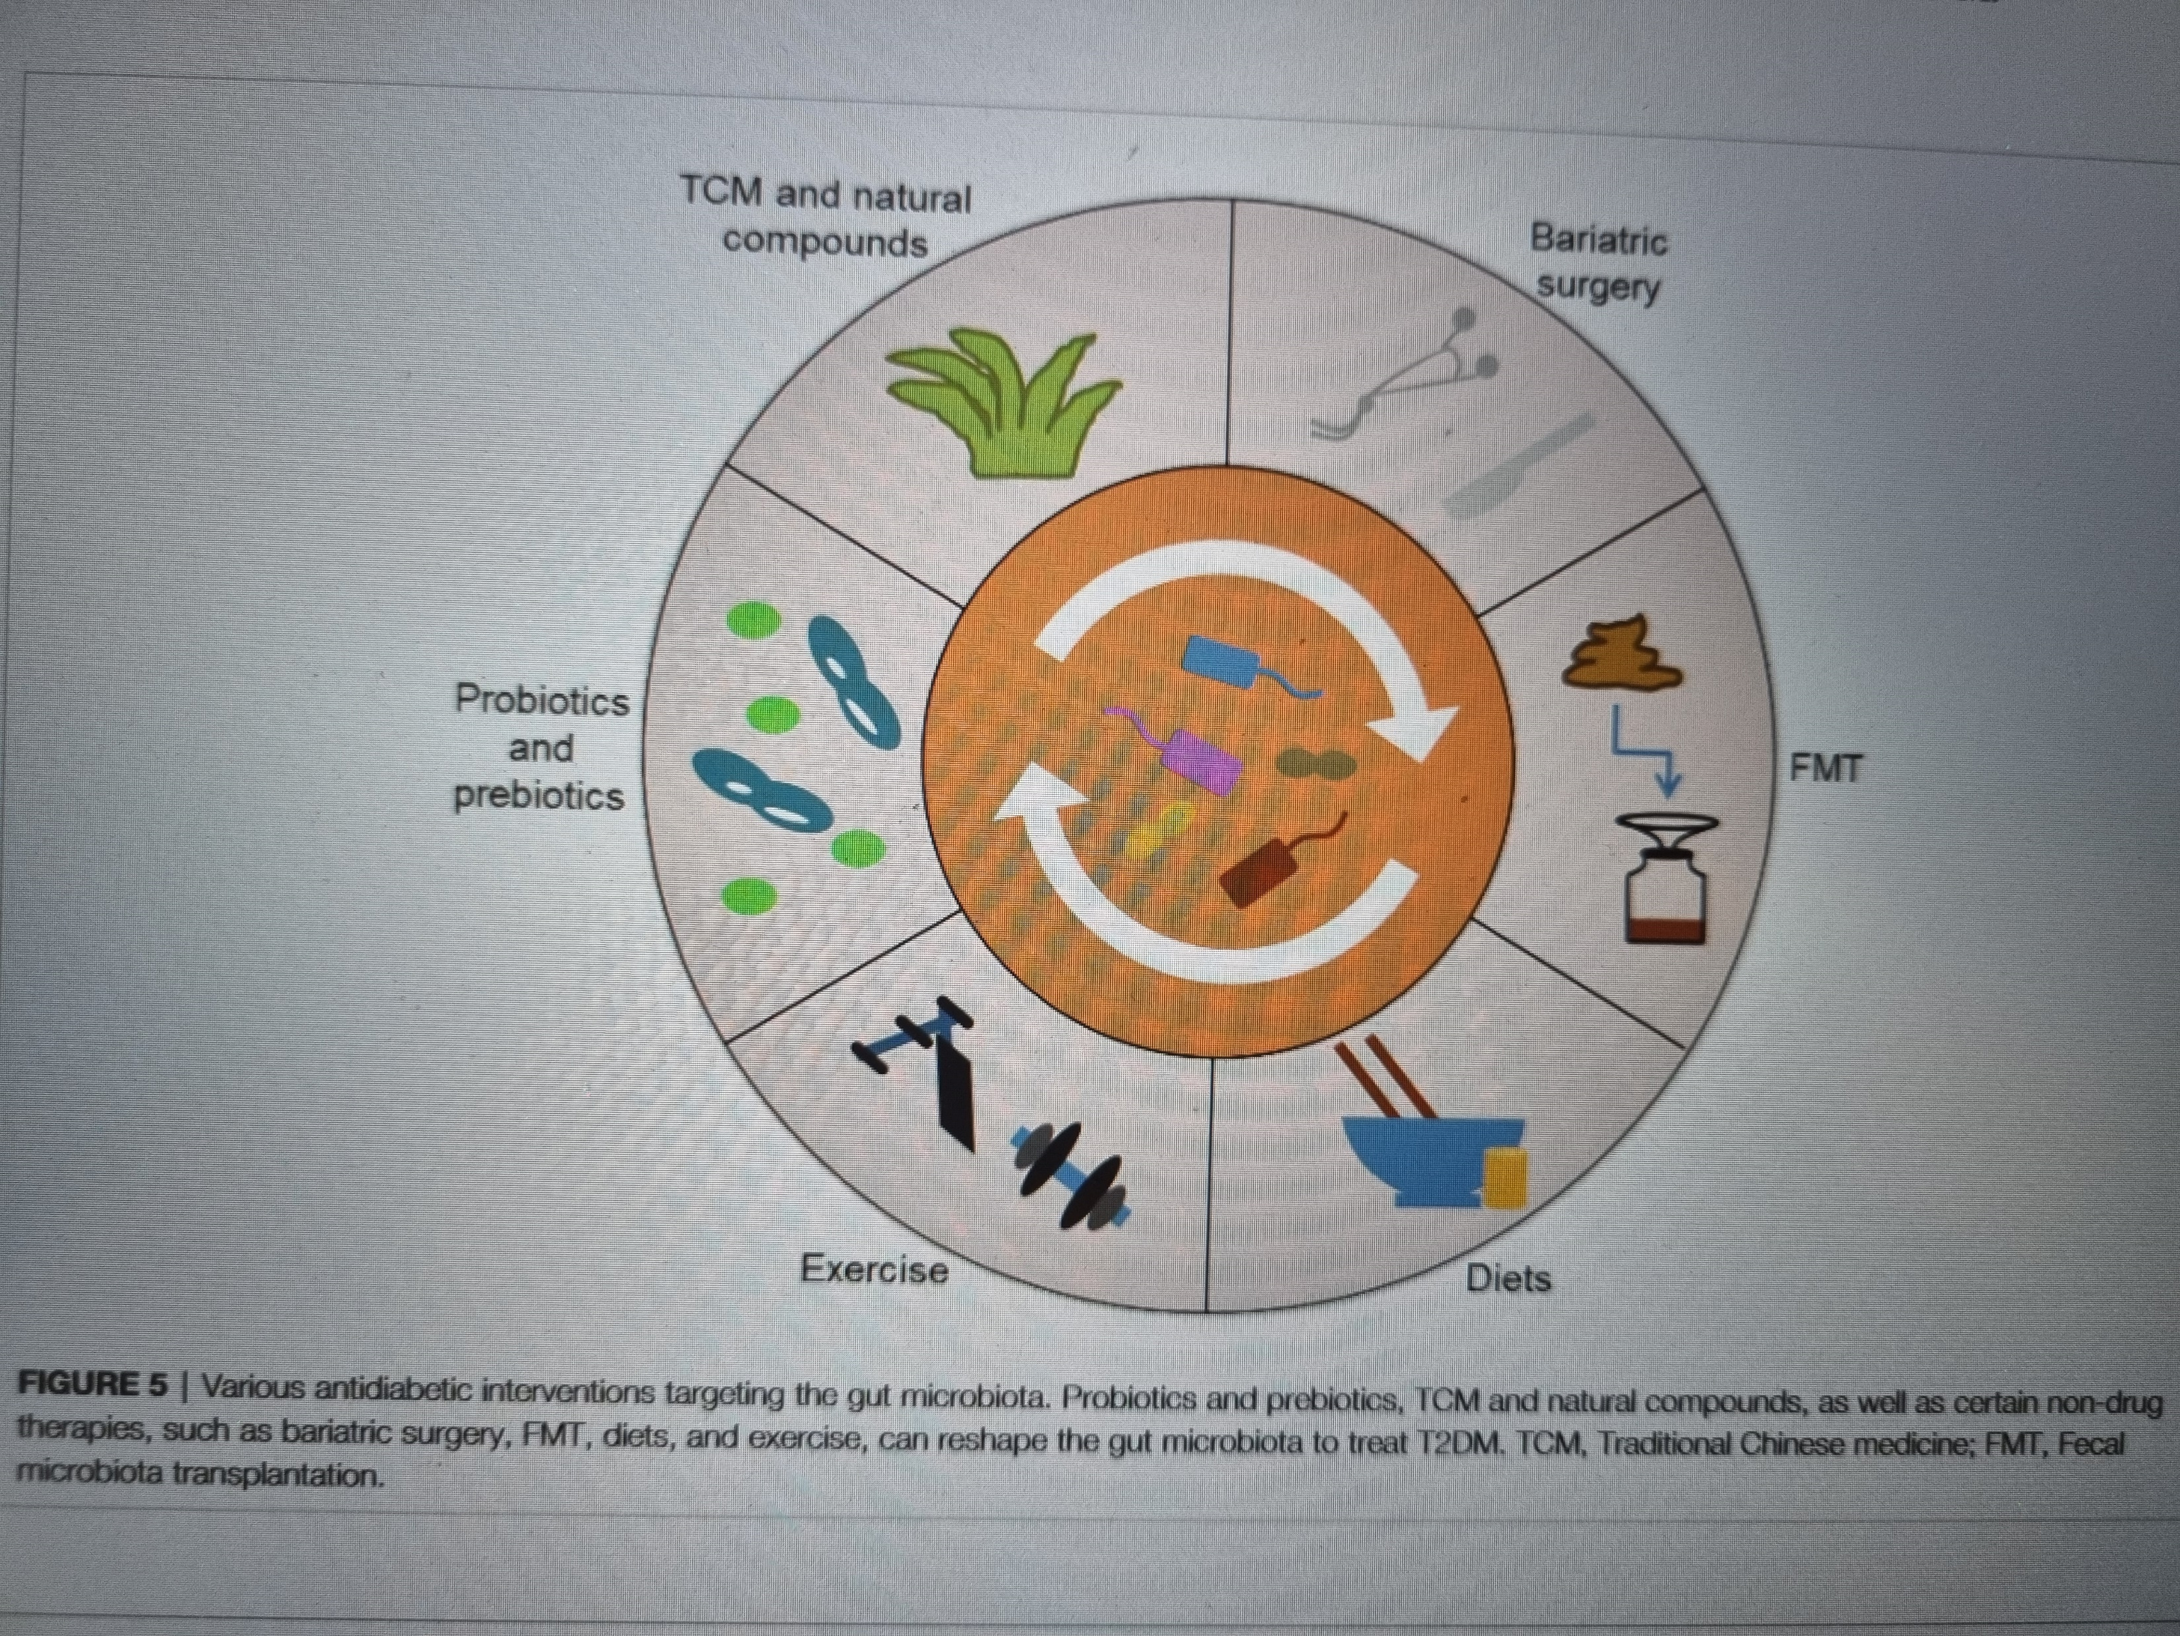

Slide 3
ZAKLJUČAK
PROMJENE MIKROBIOTE U BOLESNIKA SA TIPOM 1, TIPOM 2, GESTACIJSKIM DIJABETESOM, LADA DIJABETESOM-DOVODE DO ZAKLJUČKA DA JE CRIJEVNA MIKROBIOTA VAŽAN REGULATOR METABOLIZMA GLUKOZE I IMUNOLOŠKOG ODGOVORA
OBEĆAVAJUĆA ZA KLINIČKU PRIMJENU JE UPOTREBA PROBIOTIKA I PREBIOTIKA ( Lee Y i sur 2021.)

Slide 4
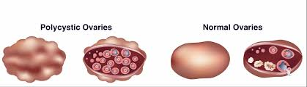
PCOD SINDROM
Najčešći endokrinološki poremećaj kod žena u generativnoj dobi i uzrok neplodnosti
Klinička slika- hiperandrogenemija, anovulacija, neredoviti ciklusi, infertilitet, pretilost, hiperinzulinemija i inzulinska rezistencija

Slide 5
U skrbi ginekologa i endokrinologa i dermatologa
Terapija- lijekovi koji smanjuju inzulinsku rezistenciju:
Metformin
Inozitoli
Vitamin D
OHC

Slide 6
PCOD i MIKROBIOTA
Mikrobiota žena sa PCOD- manje je raznolika od zdravih žena, što je vezano sa hiperandrogenizam i za povišene markere sistemske upale u organizmu.
Propusnost crijevne stijenke je zato veća

Slide 7
Meta-analiza-6 RCT studija- 406 žena sa PCOD
25-28 godina
Koristile probiotike 8-12 tjedana( Lactobacillus acidophilus, Lactobacillus casei, Bifidobacterium roda)
REZULTATI- snižene razine inzulina natašte, triglicerida i VLDL- ali bez promjene u:
Glikemiji natašte, HOMA-IR, ostalim lipidima, tjelesnoj masi, CRP, DHEAS

Slide 8
ZAKLJUČAK
UVIDOM U LITERATURU-
Minerali, vitamini, probiotici- mogu bit korisne u ublažavanju simptoma PCOD
Daljnja ispitivanja, dobro dizajnirana i kontrolirana da dokažu značajnost ovih suplemenata..

Slide 9

PRETILOST

Slide 10
PREVALENCIJA KOMPLIKACIJA PRETILOSTI
Body mass index ≥30
3% Stroke
21% Myocardial infarction
3.5% Congestive heart failure
29% NAFLD
8% Ischemic heart disease
35% GERD symptoms*
Z
9% PCOS
~40% OSAS
Z
Z
Z
19% Major depression
51% Hypertension
21% Diabetes
52% Knee osteoarthritis
*Weekly heartburn and regurgitation.
GERD, gastro-oesophageal reflux disease; NAFLD, nonalcoholic fatty liver disease; OSAS, obstructive sleep apnoea syndrome; PCOS, polycystic ovary syndrome.
1. Simon GE et al. Arch Gen Psychiatry 2006;63:824–30; 2. Su W et al. J Med Economics 2015;18:886–97; 3. López-Velázquez JA et al. Ann Hepatol 2014;13:166–78; 4. Yildiz BO et al. J Clin Endocrinol Metab. 2008;93:162–68;
5. El-Serag HB et al. Am J Gastroenterol. 2005;100:1243–50; 6. Prieto-Alhambra D et al. Ann Rheum Dis 2014;73:1659–64; 7. Modena DAO et al. Rev Assoc Med Bras 1992;63:852–8.
Notes:
The National Comorbidity Survey Replication (NCS-R) and the 2005–2012 National Health and Nutrition Examination Survey (NHANES) were used to compare prevalence of mental and metabolic comorbidities in populations with and without obesity¹
In the NCS-R data, obesity was associated with an approximately 25% increase in the prevalence of mood and anxiety disorder, and an approximately 20% decrease in prevalence of substance abuse¹
The NHANES data described the relationship between obesity and metabolic comorbidities. In a demographic of 100,000 adults with obesity compared with 100,000 adults with normal weight, adults with obesity had a higher prevalence of diabetes, hypertension, heart failure, history of myocardial infarction, ischemic heart disease, and stroke²
Correlation between the prevalence of Obesity and NAFLD was estimated with data from the prevalence of obesity for each country. NAFLD prevalence was estimated assuming that about 80% of patients with obesity might develop NAFLD. Based on the prevalence of obesity, the prevalence rates of NAFLD are estimated as 26% in Mexico, 29% in the USA, 15-20% in Central America, and 28% in Belize and Barbados³
Data from two consecutive population studies assessing the prevalence of PCOS and a database containing all untreated patients with PCOS were evaluated at a University clinic between 1987 and 2002. The prevalence rates of PCOS in women with underweight, normal-weight, overweight, and obesity were 8.2, 9.8, 9.9, and 9.0%, respectively. The results suggest that the risk of PCOS is only minimally increased with obesity⁴
A cross sectional study was carried out to determine the prevalence and risk factors of GERD in volunteers (N=450) who completed a Gastroesophageal Reflux Questionnaire and were invited for upper endoscopy with biopsies. More patients with overweight and obesity reported weekly GERD symptoms (34.6%, weekly heartburn and regurgitation; 15%, severe heartburn and regurgitation)⁵
In a large Spanish study cohort of patients in primary care, 52% of patients with obesity were found to have knee osteoarthritis⁶
Although prevalence rates of obstructive sleep apnoea syndrome are difficult to determine due to underdiagnosis, approximately 40% of people with obesity are thought to have obstructive sleep apnoea⁷
References
Simon et al. Association between obesity and psychiatric disorders in the US adult population. Arch Gen Psychiatry 2006;63:824–30.
Su et al. Modeling the clinical and economic implications of obesity using microsimulation. J Med Economics 2015;18:886–97.
López-Velázquez et al. The prevalence of nonalcoholic fatty liver disease in the Americas. Ann Hepatol 2014;13(2):166–78.
Yildiz et al. Impact of obesity on the risk for polycystic ovary syndrome. J Clin Endocrinol Metab. 2008;93(1):162–168.
El-Serag et al. Obesity is an independent risk factor for GERD symptoms and erosive esophagitis. Am J Gastroenterol. 2005;100(6):1243–50
Prieto-Alhambra et al. Incidence and risk factors for clinically diagnosed knee, hip and hand osteoarthritis: influences of age, gender and osteoarthritis affecting other joints. Ann Rheum Dis 2014;73:1659–64
Modena et al. Obstructive sleep apnea syndrome among individuals with obesity: A cross-sectional study. Rev Assoc Med Bras 1992;63:852–8

Slide 11



LIJEČENJE INDIVIDUALNO

Slide 12
STRATEGIJA LIJEČENJA PRETILOSTI
Behavioral interventions
Pharmacotherapy
Bariatric surgery
Counselling
Diet
Orlistat*†‡
Gastric band
Roux-en-Y Gastric Bypass
Liraglutide 3.0 mg*†‡
Self-
monitoring
Physical activity
Phentermine/topiramate†
Naltrexone/bupropion*†‡
Sleeve gastrectomy
Biliopancreatic diversion
Stress management
Sleep management
Semaglutide 2.4 mg†‡
Setmelanotide*†
*approved by the EMA; †approved by the FDA; ‡approved by Health Canada.
1. Garvey et al. Endocr Pract. 2016:1–203; 2. Mechanick JI et al. SOARD. 2020;16:175-247; 3. Wharton et al. CMAJ. 2020;192:E875-91; 4. FDA approved drugs. Available at: http://www.fda.gov/Drugs/default.htm. Accessed October 2022; 5. Pharmacotherapy in Obesity Management. Obesity Canada. 2022. Available at: https://obesitycanada.ca/wp-content/uploads/2022/10/Pharmacotherapy-CPG-2022_final.pdf. Accessed November 2022; 6. EMA approved drugs. Available at: http://www.ema.europa.eu/. Accessed October 2022.
Notes:
Treatment strategies for obesity include behavioral interventions, pharmacotherapy, and bariatric surgery
behavioral interventions that focus on counselling, diet, physical activity, self-monitoring, sleep and stress management can be used to manage obesity
Pharmacotherapy using medications such as Orlistat, Stemelanoride, and Metreleptin can also be used
Phentermine/topiramate are not approved for weight management in the EU
Bariatric procedures such as gastric band, sleeve gastrectomy, biliopancreatic diversion, and Roux-1n-Y gastric bypass can also be performed to treat obesity
References:
Garvey et al. AMERICAN ASSOCIATION OF CLINICAL ENDOCRINOLOGISTS AND AMERICAN COLLEGE OF ENDOCRINOLOGY COMPREHENSIVE CLINICAL PRACTICE GUIDELINES FOR MEDICAL CARE OF PATIENTS WITH OBESITY. Endocr Pract 2016:1–203
Mechanick JI et al. Clinical practice guidelines for the perioperative nutrition, metabolic, and nonsurgical support of patients undergoing bariatric procedures - 2019 update: cosponsored by American Association of Clinical Endocrinologists/American College of Endocrinology, The Obesity Society, American Society for Metabolic & Bariatric Surgery, Obesity Medicine Association, and American Society of Anesthesiologists. SOARD 2020;16:175-247
Wharton et al. Obesity in adults: a clinical practice guideline. CMAJ 2020 August 4;192:E875-91. doi: 10.1503/cmaj.191707
FDA approved drugs available at: http://www.fda.gov/Drugs/default.htm. Last accessed October 2022
EMA approved drugs. Available at: http://www.ema.europa.eu/. Last accessed October 2022.

Slide 13
PROBIOTICI I DEBLJINA
Lactobacillus i Bifidobacterium vrste uspješno se koriste u animalnim modelima za debljinu zbog njihovog niskog stupnja patogenosti i rezistencije na antibiotike (Cerdo i sur., 2019.).Terapija sa ovim probioticima dovela je do različitog stupnja pada porasta tjelesne mase i smanjenog nakupljanja masnog tkiva- u usporedbi sa placebo grupom.
Međutim ove rezultate nisu potvrdili rezultati drugih studija (Luoto i sr.,2010.).

Slide 14
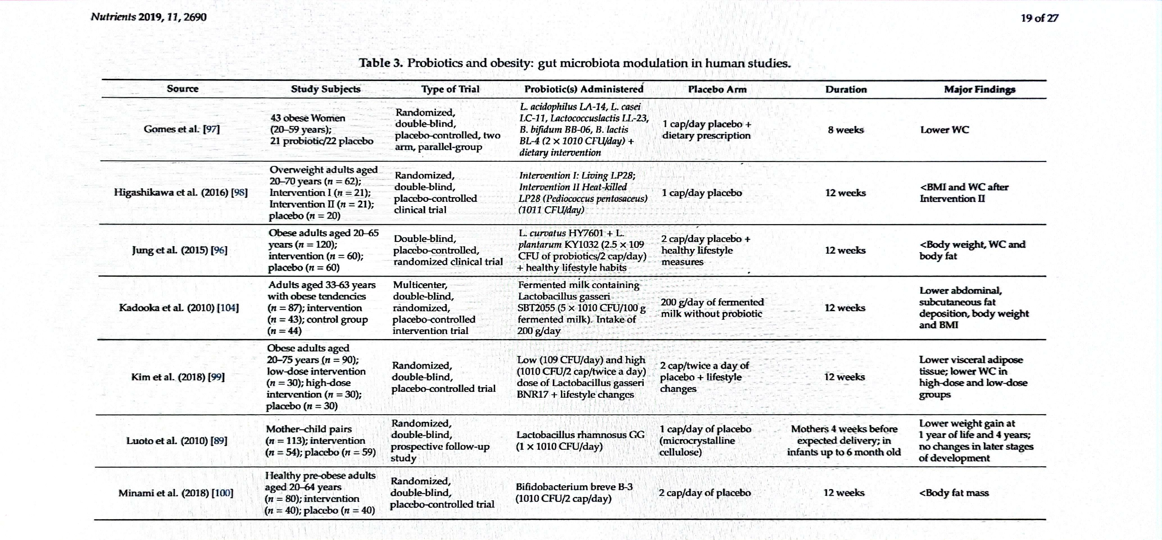

Slide 15
Jedna od „vrućih”interesantnih tema u medicini je pitanje crijevne mikrobiote i pretilosti.
Određeni metabolički putovi upućuju na moguću povezanost promjena u sastavu crijevne mikrobiote i razvoja pretilosti-a a sama pandemija traži učinkoviti lijek u prevenciji i liječenju.
MEĐUTIM:
Različitost u rezultatima studija- mogu se pripisati različitom dizajnu, različitim populacijama ispitanika, različitom genomu..
Uz to heterogenost metoda koje određuju crijevnu mikrobiotu ne omogućuju direktnu usporedbu rezultata studija..potrebna standardizacija tih metoda za kvalitetnije i pouzdanije zaključke..

Slide 16
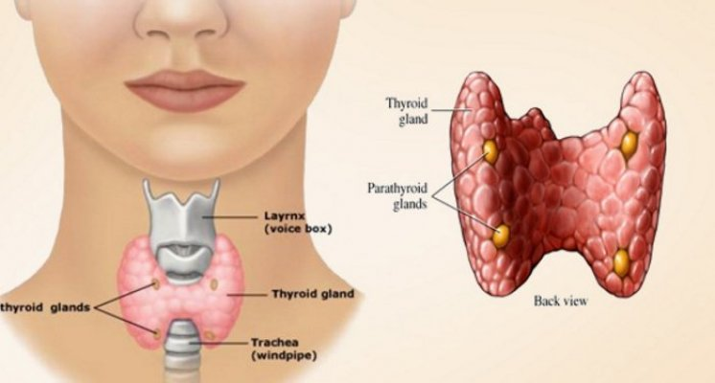
ŠTITNJAČA I MIKROBIOTA

Slide 17
CRIJEVNA MIKROBIOTA- korisni učinak na imunološki sistem, i na funkciju štitnjače
Bolesti crijeva i štinjače- povezane su:
Hashimotova bolest+Gravesova bolest- sa Celijakijom
Patofiziološki- očtećena intestinalna sluznica, dovodi do povećana propusnosti crijeva i ulaska antigena u cirkulaciju. Oni aktiviraju imunološki sistem i unakrsno reagiraju sa tkivom izvan crijeva.
Autoimune bolesti štitnjače- povezane su sa DISBIOZOM mikrobiote U CRIJEVU

Slide 18
DISBIOZA prisutna i kod karcinoma štitnače
MIKROBIOTA- ima utjecaj na bioraspoloživost mikronutrijenata za štitnjaču -npr.
J,Fe,Cu- važni za sintezu levotiroksina i trijodtironina
Se, Zn važni za konverziju T4 u T3- uz vit D
U autoimunim bolestima, mikronutrijenti SNIŽENI

Slide 19
STUDIJE
U hipotireozi i hipertireozi- SNIŽENE se Lactobacillaceae i Bifidobacteriaceae.
Na animalnim modelima( miševi), suplementacija Lactobacilis reuteri utvrdila je porast free T4 ( pretpostavlja se zbog porasta interleukina 10 i oporavka regulatornih T limfocita (Virili C. i sur. 2018.)
Suplementacija simbiotika – pokazala je korisni učinak kod pacijenata sa hipotireozom, u smislu pada TSH, smanjenja doze levotiroksina, umora i porasta free T3 (Talebi S i sur., 2020.).

Slide 20
PROBIOTICI- POKAZUJU KORISTAN UČINAK NA FUNKCIJU ŠTITNJAČE U CJELINI

Slide 21
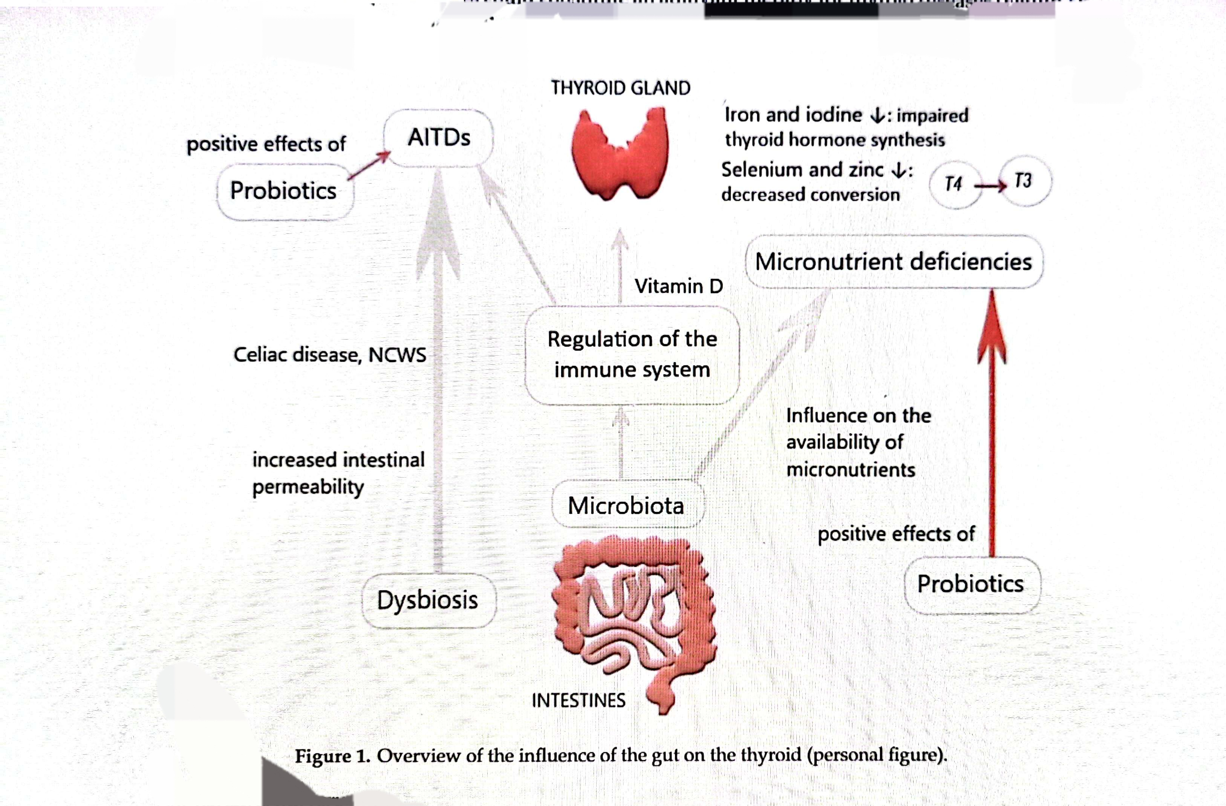

Slide 22

Hvala !

