Slide 1
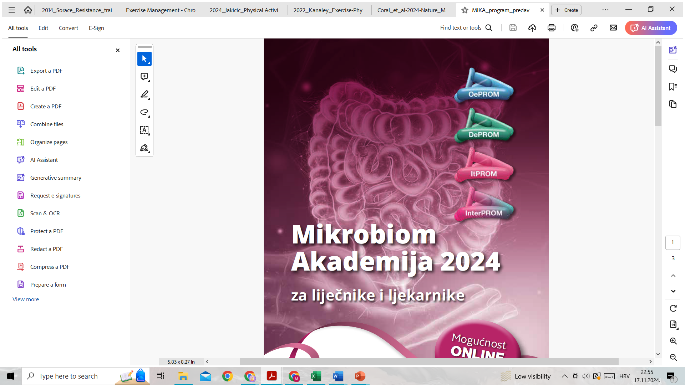



Povezanost mikronutrijenata, genetskog polimorfizma FTO gena i oralne mikrobiote u žena s pretilošću
22. – 23. 11. 2024.
Hotel Antunović Zagreb
doc.dr.sc. Martina Matovinović,dr.med.
Internist, endokrinolog i dijabetolog
Klinički bolnički centar Zagreb
Kineziološki fakultet Sveučilišta u Zagrebu
Notes:
Mikrobiota ima značajan utjecaj na zdravlje, a njezine promjene mogu biti jedan od važnih čimbenika za razvoj i progresiju metaboličkog sindroma. Mehanizmi kojima mikrobiota može doprinijeti razvoju metaboličkog sindroma su disbioza mikrobiote i povećana propusnost crijeva. Metabolički sindrom je povezan sa smanjenim udjelom probiotskih bakterija poput Bifidobacteria,a povećanjem propusnosti crijeva dolazi do ulaska lipopolisaharida u krvotok koji može doprinjeti razvoju kronične upale niskog intenziteta. Neke bakterije povećavaju unos kalorija iz hrane i potiču debljanje, dok druge mogu imati suprotan učinak. Crijevne bakterije fermentiraju dijetalna vlakna u kratkolančane masne kiseline koje mogu imati pozitivan učinak na metabolizam i regulaciju energije. Probiotici i prebiotici mogu pomoći u obnavljanju zdrave crijevne flore, smanjenju upala i poboljšanju metaboličkih funkcija.

Slide 2
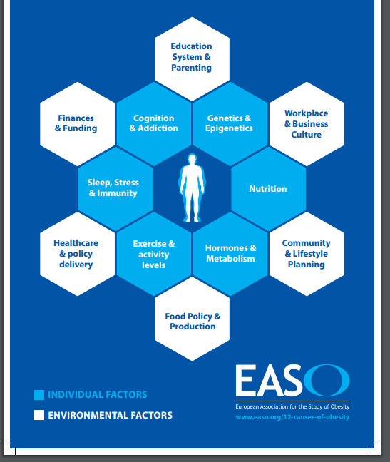
Causes of obesity

Slide 3
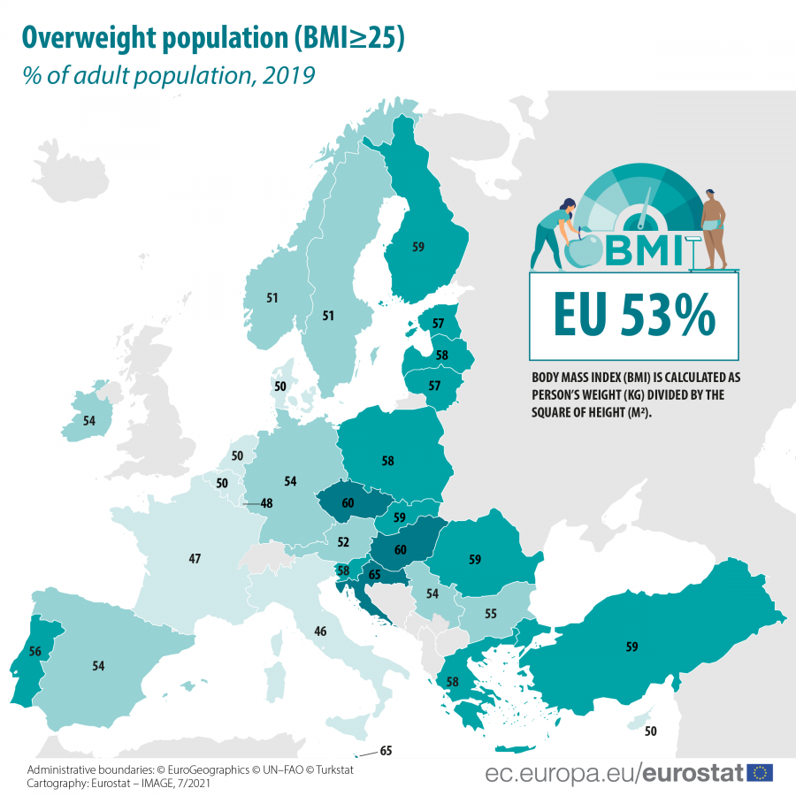
Overweight adult population, EUROSTAT
BMI >30kg/m2
17% obese
https://ec.europa.eu/eurostat/statistics-explained/index.php?title=File:Overweight_population_map_July_2021_V2.png
Notes:
https://ec.europa.eu/eurostat/statistics-explained/index.php?title=File:Overweight_population_map_July_2021_V2.png

Slide 4
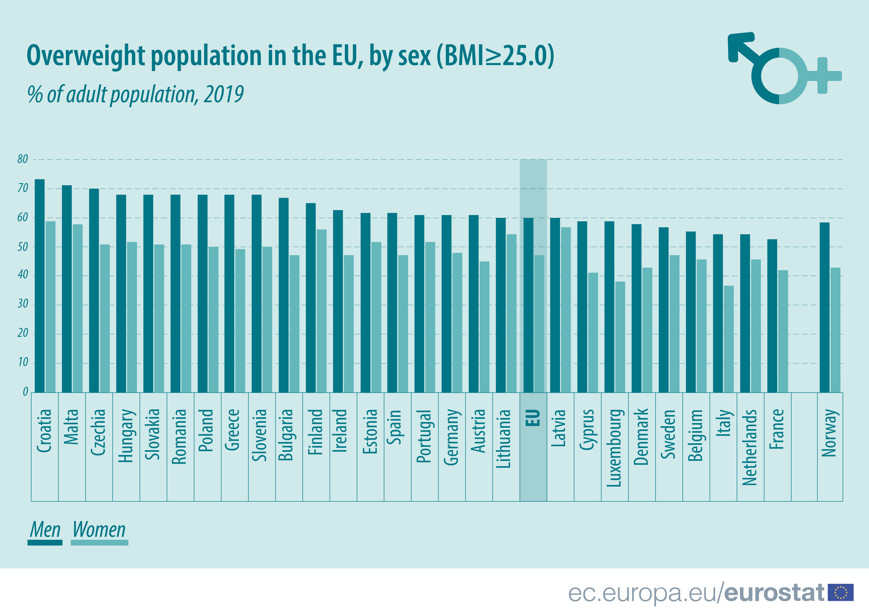
Overweight population in the EU
23 % of adults in Croatia are
Obese
65% of adults in Croatia are overweight
https://ec.europa.eu/eurostat/statistics-explained/index.php?title=File:Overweight_population_map_July_2021_V2.png

Slide 5
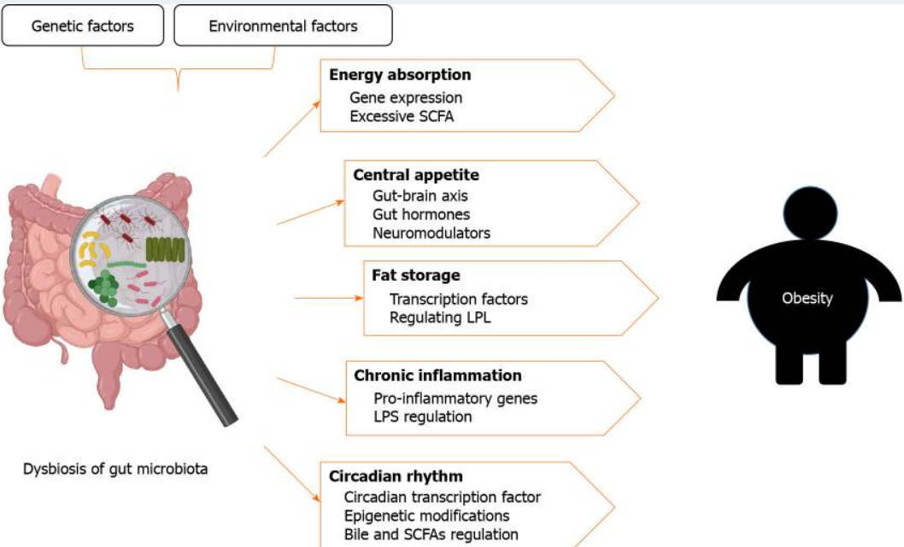
Genetic and environmental factors can cause dysbiosis of the gut microbiota
Liu BN et al. Gut microbiota in obesity. World J Gastroenterol. 2021;27(25):3837-3850.
Notes:
Both genetic and environmental factors can cause dysbiosis of the gut microbiota. Dysbiosis can increase energy absorption through changes in gene expression and excessive accumulation of short-chain fatty acids (SCFAs); improve central appetite through gut-brain axis, gut hormones, and neuromodulators; regulate fat storage through transcription factors and lipoprotein lipase; cause chronic inflammation through regulation of inflammatory gene expression and lipopolysaccharide; and disrupt the circadian rhythum by affecting the circadian transcription factors, epigenetic modifications, and the synthesis of bile and SCFAs. These factors appear to increase susceptibility to obesity. The figure was created with BioRender.com. SCFA: Short-chain fatty acids; LPL: Lipoprotein lipase; LPS: Lipopolysaccharide.

Slide 6
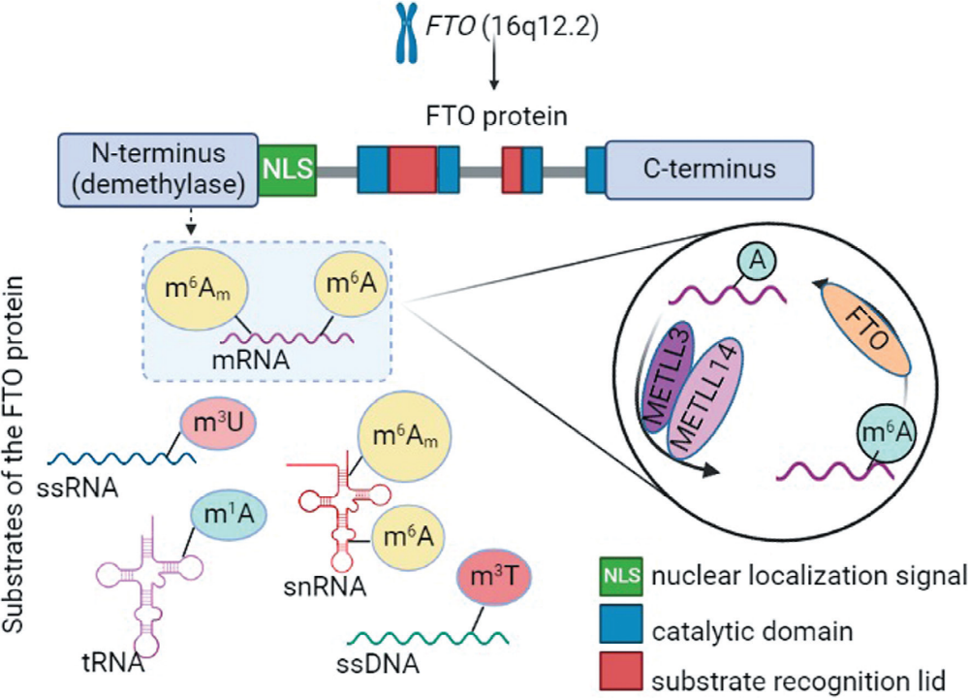
GEN FTO (fat mass and obesity associated gene)
The FTO gene was discovered as the first obesity susceptibility gene identified by a genome-wide association study (GWAS) in 2007.
FTO is more than 400 kb long
9-exon gene located on human chromosome 16 at position q12.2
Popović, Ana-Marija; Huđek Turković, Ana; Žuna, Kristina; Bačun-Družina, Višnja; Rubelj, Ivica; Matovinović, Martina. FTO Gene Polymorphisms at the Crossroads of Metabolic Pathways of Obesity and Epigenetic Influences. Food Technology and Biotechnology (2022).
Notes:
Popović, Ana-Marija; Huđek Turković, Ana; Žuna, Kristina; Bačun-Družina, Višnja; Rubelj, Ivica; Matovinović, Martina. FTO Gene Polymorphisms at the Crossroads of Metabolic Pathways of Obesity and Epigenetic Influences. Food Technology and Biotechnology (2022).

Slide 7
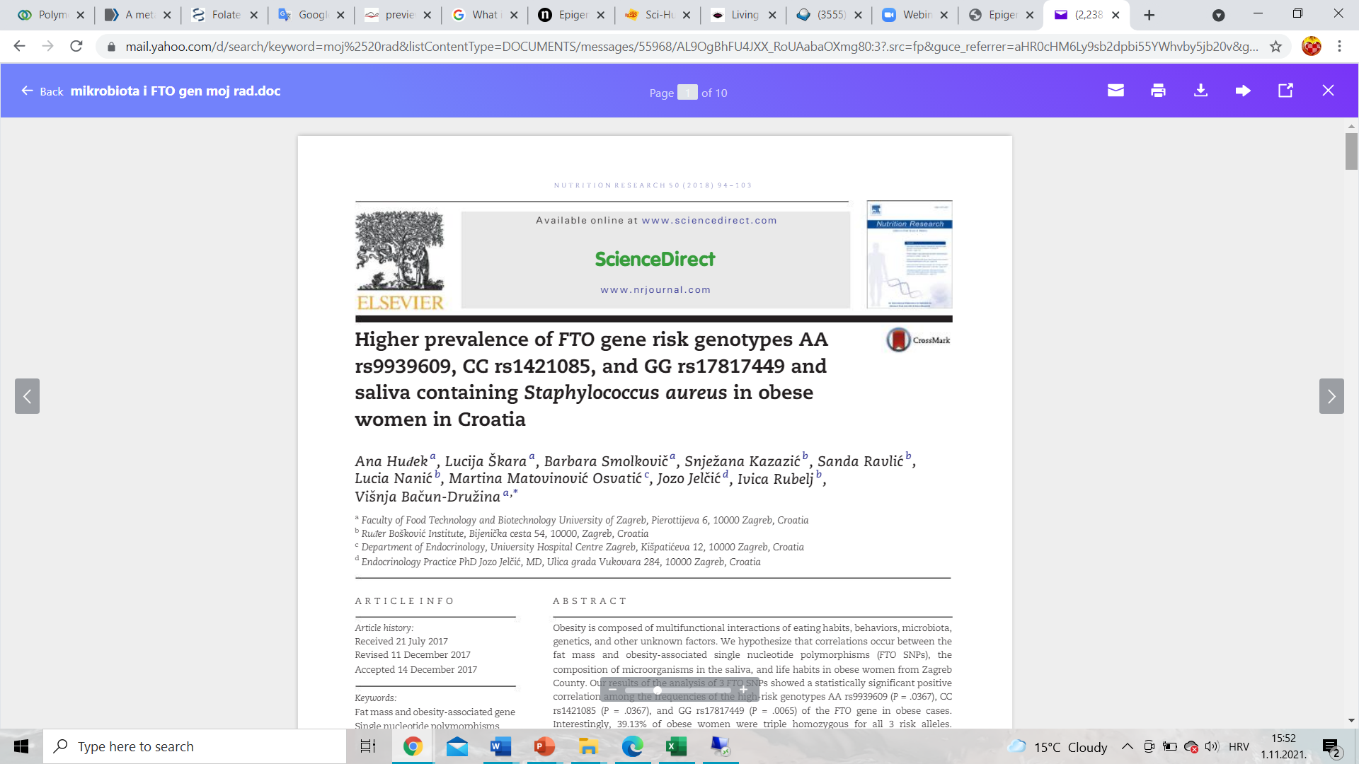
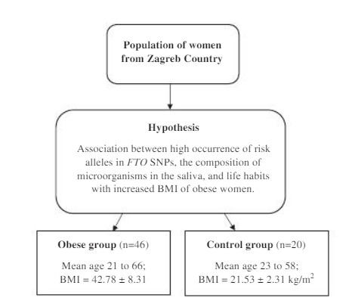
Huđek A et al. 2018. Higher prevalence of FT0 gene risk genotypes AA rs9939609, CC rs1421085, and GG rs17817449 and saliva containing Staphylococcus aureus in obese women in Croatia. Huđek A et al. 2018.
Notes:
Nedorađene obrade..objavljeni radovi
Higher prevalence of FTP gene risk genotypes AA rs9939609, CC rs1421085, and GG rs17817449 and saliva containing Staphylococcus aureus in obese women in Croatia. Huđek A et al. 2018.

Slide 8
Study design
determine whether the obesity-associated genotypes of the FTO gene SNPs (rs9939609, rs1421085 and rs17817449) are more common in obese than in lean women from Zagreb County
determine the qualitative difference in the bacterial composition of saliva
lifestyle habits between a control group and women with obesity

Slide 9
Blood and saliva sampling
venous blood samples (2 ml) were collected in tubes with EDTA-anticoagulated which were frozen at -20°C
Saliva samples (2 ml) were collected using sterilized centrifuge tubes after rinsing the mouth with 15 ml of sterile saline solution
After sampling, the tubes with saliva were stored at -20°C.

Slide 10
Blood and saliva sampling
Genomic DNA was isolated from peripheral blood using
Real-time PCR reactions and genotyping
FTO gene genotypes AA rs9939609, CC rs1421085, and GG rs17817449
The de Man-Rogosa-Sharpe (MRS) and Luria-Bertani (LB) agar plates were inoculated with 0.5 ml of saliva, diluted with 0.5 ml of phosphate buffer (pH=7.2)
then incubated in a thermostat under aerobic conditions at 37°C for 2 days
Colonies with different phenotypes were selected and transferred by streaking onto a new agar plate, incubated under aerobic conditions at 37°C for 1 day to obtain pure colonies
Single colonies were identified mass spectrometer

Slide 11
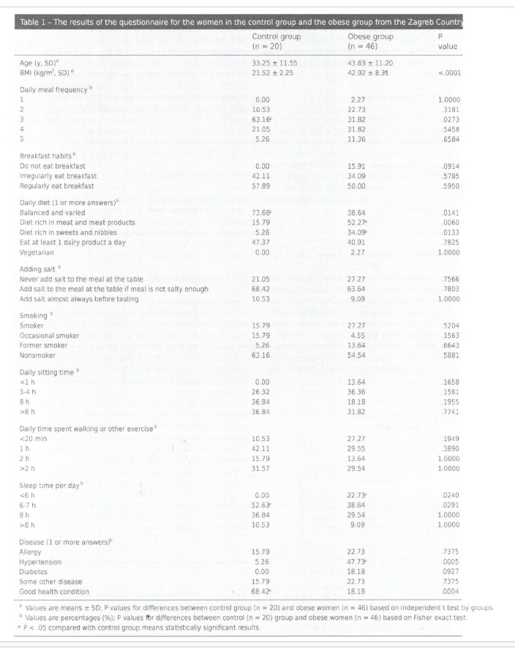
More woman with obesity rated their diet as rich in sweets and nibbles (P = .0133) and rich in meat and meat products (P =. 0060)
The sleeping time is significantly different between the obese
and lean women
The obese women slept less than 6 hours (P = .0240)
Women from the control group slept 6-7 hours (P= .0291)

Slide 12
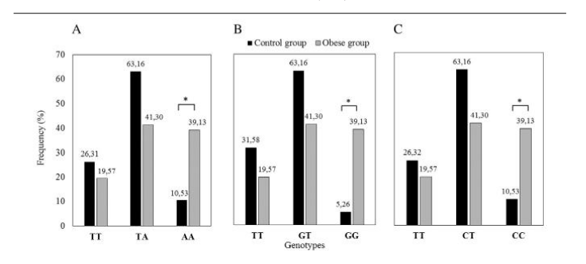
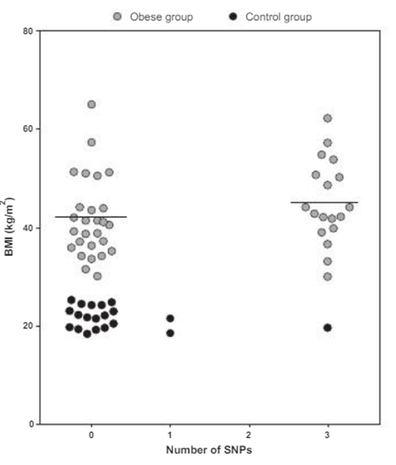
Higher prevalence of FTO gene risk genotypes AA rs9939609, CC rs1421085, and GG rs17817449
statistically significant difference between the control group and women with obesity in the frequency of the SNPs
rs9939609 AA genotype with P = .0367
rs17817449,GG genotype with P = .0065
rs1421085 the frequency of the CC genotype with P = .0367

Slide 13
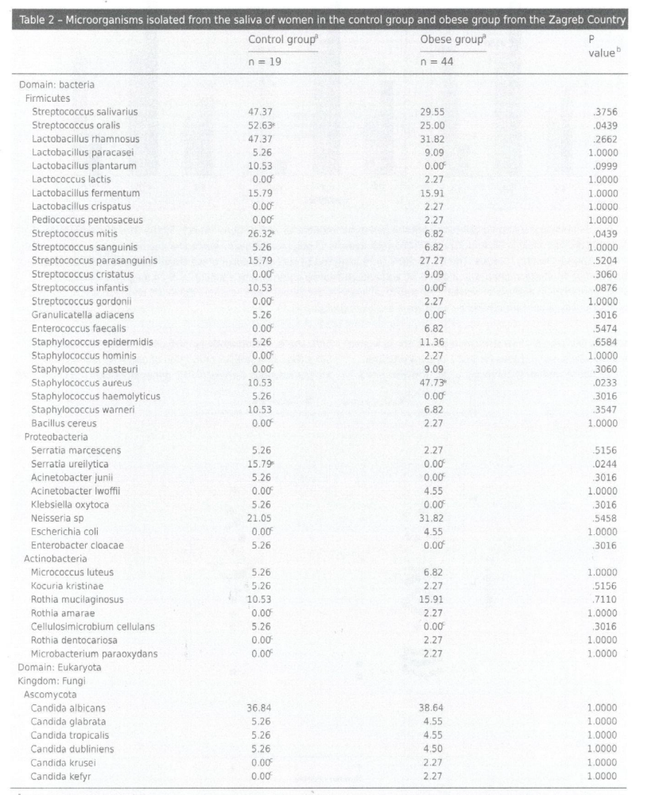
Microorganisms isolated from the saliva of women in the control group and obese group from the Zagreb Country
3 bacterial phyla (Firmicutes, Proteobacteria and
Actinobacteria) and 6 Candida species from phylum Ascomycota, kingdom Fungi
Streptococcus was the dominant genus that accounted for 6 different species in the saliva of normal-weight women
statistically higher percentage of Staphylococcus aureus (P = .0233) was detected in the obese individuals

Slide 14
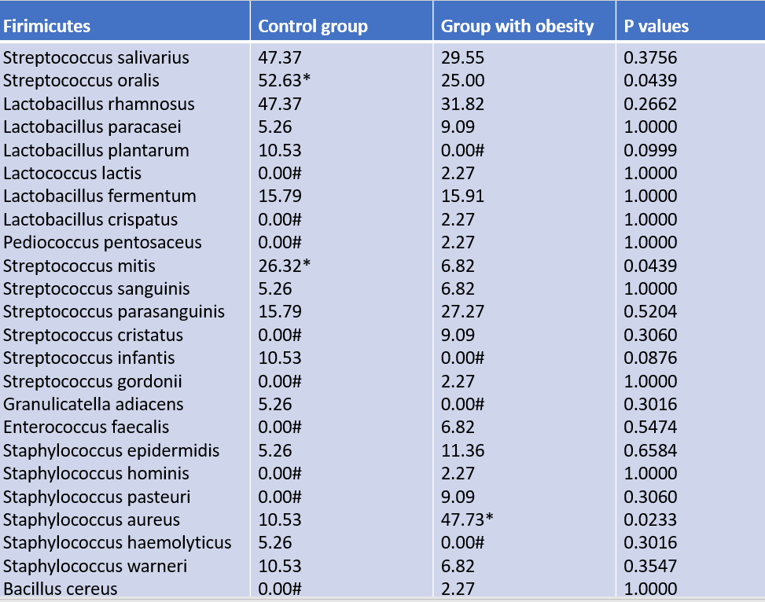
Microorganisms isolated from the saliva of women in the control group and group with obesity from the Zagreb Country
Control group
Streptococcus oralis (P = .0439),
Streptococcus mitis (P = .0439)
Staphylococcus aureus (P = .0233)
was detected in the individuals with obesity

Slide 15
Oral microbiota
Proteobacteria | Control group | Group with obesity | P values
Serratia marcescens | 5.26 | 2.27 | 0.5156
Serratia ureilytica | 15.79* | 0.00# | 0.0244
Acinetobacter junii | 5.26 | 0.00# | 0.3016
Acinetobacter lwoffii | 0.00# | 4.55 | 1.0000
Klebsiella oxytoca | 5.26 | 0.00# | 0.3016
Neisseria sp. | 21.05 | 31.82 | 0.5458
Escherichia coli Enterobacter cloacae | 0.00# 5.26 | 4.55 0.00# | 1.0000 0.3016
Serratia ureilytica (P = .0244) significantly dominated in the control group

Slide 16
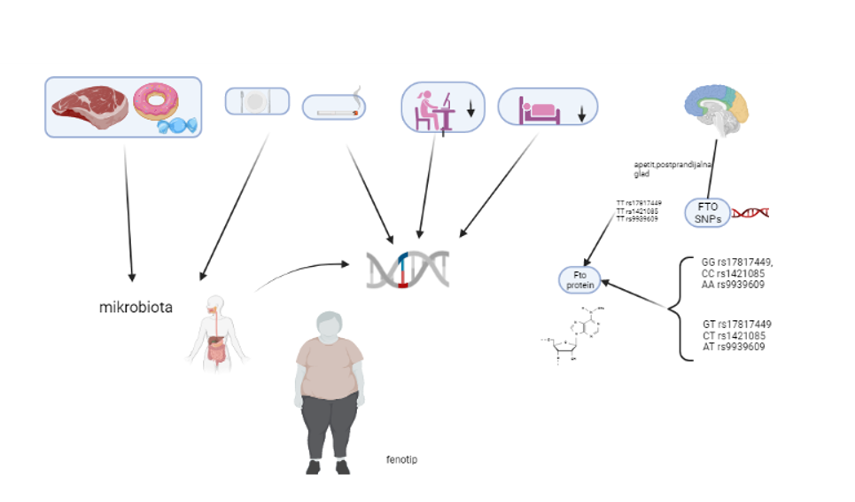
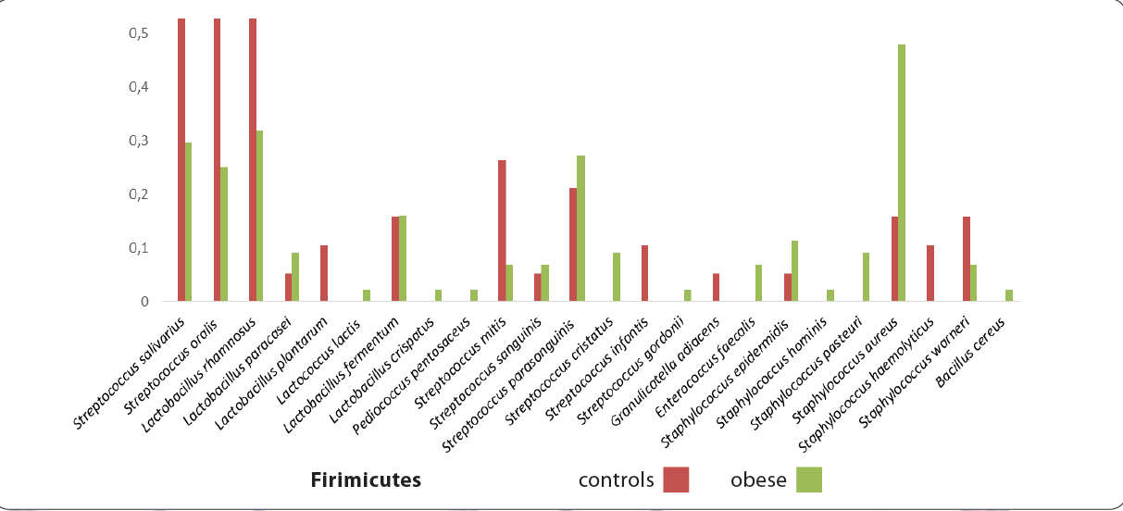
Huđek A. et al. Higher prevalence of FTO gene risk genotypes AA rs9939609, CC rs1421085, and GG rs17817449 and saliva containing Staphylococcus aureus in obese women in Croatia. 2018.
Notes:
increased FTO expression is associated with weight gain and higher BMI.

Slide 17
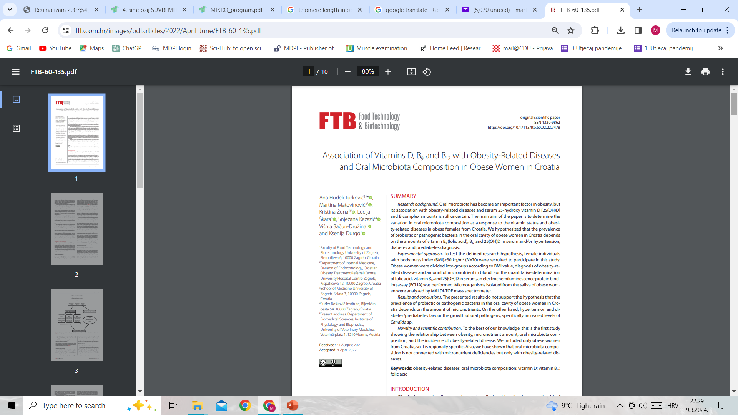

Slide 18
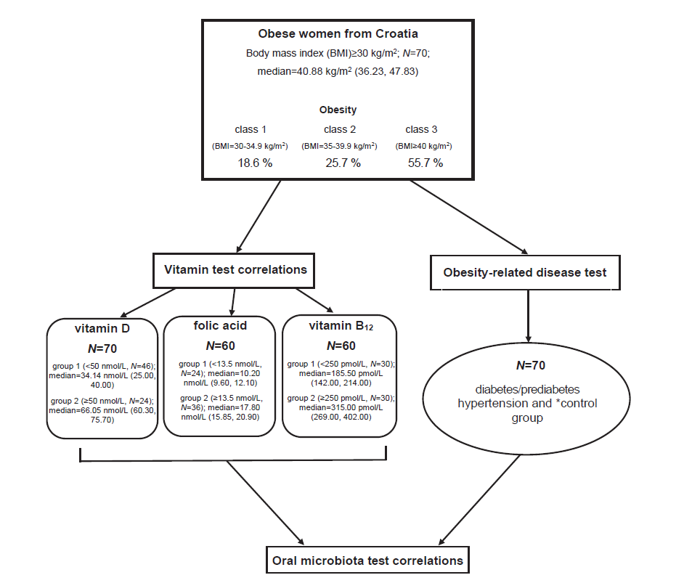

Slide 19
Oral microbiota
In this work we isolated 118 different species of bacteria
5 different phyla: Firmicutes, Actinobacteria, Proteobacteria, Bacteroidetes and Fusobacteria
13 different species of fungi (2 different phyla: Ascomycota and Basidiomycota)
34 potentially pathogenic and 22 potentially probiotic bacteria

Slide 20


Slide 21
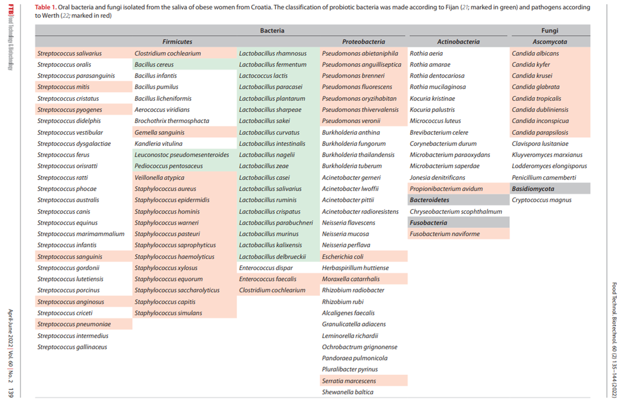
Oral microbiota
There was a positive correlation between the number of oral Proteobacteria and Firmicutes bacteria (Spearman’s rho CC=0.284, p=0.017)
Zeigler et al. also reported bacteria from Proteobacteria phylum and individual Neisseria mucosa to be present in sixfold higher amounts in the saliva of obese adolescent subjects
Yang et al. showed that Proteobacteria and Firmicutes bacteria were significantly associated with an increased obesity prevalence in obese individuals from the Southern Community Cohort Study, USA
Zeigler CC et al. Microbiota in the oral subgingival biofilm is associated with obesity in adolescence. Obesity. 2012;20(1): 157–64.
Yang Y et al. Oral microbiome and obesity in a large study of low-income and African-American populations. J Oral Microbiol. 2019;11(1):1650597.
Notes:
Zeigler CC, Persson GR, Wondimu B, Marcus C, Sobko T, Modéer T. Microbiota in the oral subgingival biofilm is associated with obesity in adolescence. Obesity. 2012;20(1): 157–64.
Yang Y, Cai Q, Zheng W, Steinwandel M, Blot WJ, Shu X-O, et al. Oral microbiome and obesity in a large study of low-income and African-American populations. J Oral Microbiol. 2019;11(1):1650597.

Slide 22
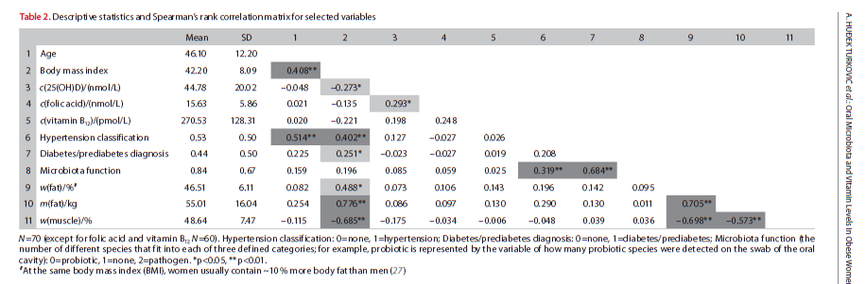
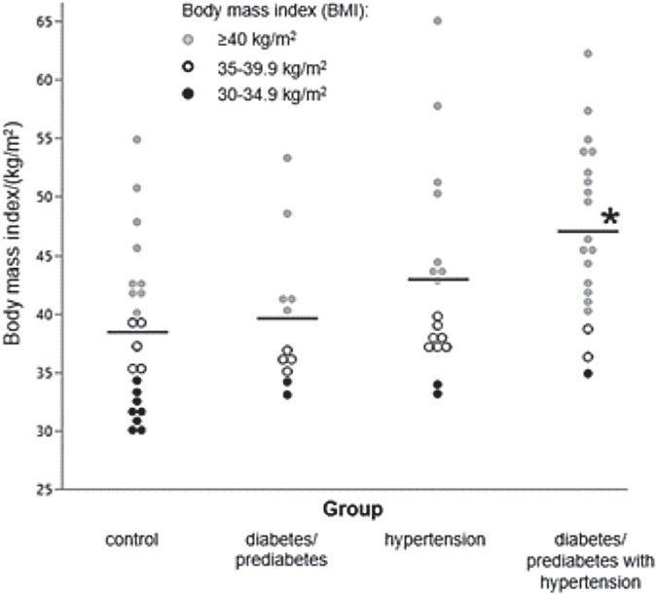
Correlation between the BMI values and incidence of hypertension and diabetes/prediabetes
there is a positive correlation between the incidence of hypertension or prediabetes/diabetes and pathogenic bacteria in the oral cavity in women with obesity

Slide 23
Oral microbiota-Fungi
the identification results of the oral microbiota showed the predominance of Candida sp. in the Ascomycota phylum
the higher BMI values (if we compare only class 1 and class 3 obesity levels), depending on the presence of diabetes/prediabetes, positively affected the number of Ascomycota in the oral cavity (factorial ANOVA, F=4.091, p=0.021)
women with obesity diabetes/prediabetes, there is a greater variety of fungi (number of different species) of the genus Candida than all 13 isolated fungi in this study (Mann-Whitney U=462.00, p=0.04)

Slide 24
Oral microbiota and 25(OH)D
25(OH)D in blood ≥50 nmol/L significantly more species of Actinobacteria were found than in those with lower values (p=0.029)
decrease in Actinobacteria in the gut, the vitamin B12 blood level was also lower
vitamin B12 as it exists in nature may be produced by Actinobacteria
long-term vitamin D deficiency may produce changes in the microbiota composition that promoted body mass gain

Slide 25
Oral microbiota-vitamin D
female individuals with concentrations of 25(OH)D in blood <50 nmol/L had a statistically significant increase of Candida sp. (p=0.022) and Lactobacillus sp. in the saliva (p=0.027)
class 3 obesity was the most prevalent in the group with lower concentration in blood of 25(OH)D (<50nmol/L)

Slide 26
Oral microbiota and vitamin D
vitamin D in the human immune response induces an antimicrobial peptide cathelicidin for the body’s ability to fight infections, candidiasis
increased oral amount of Candida sp. in the saliva of obese women with a vitamin D deficiency
Candida sp. was also positively associated with blood glucose concentrations (diabetes/prediabetes)
Man et al. showed that higher glucose concentration is directly related to Candida albicans growth, which may be associated with fungal infections that occur in non-controlled diabetic patients
van der Does AM et al. Induction of the human cathelicidin LL-37 as a novel treatment against bacterial infections. J Leukoc Biol. 2012; 92(4):735–42.
Man A et al. New perspectives on the nutritional factors influencing growth rate of Candida albicans in diabetics. An in vitro study. Mem Inst Oswaldo Cruz. 2017;112(9):587–92.
Notes:
van der Does AM et al. Induction of the human cathelicidin LL-37 as a novel treatment against bacterial infections. J Leukoc Biol. 2012; 92(4):735–42.
Man A et al. New perspectives on the nutritional factors influencing growth rate of Candida albicans in diabetics. An in vitro study. Mem Inst Oswaldo Cruz. 2017;112(9):587–92.

Slide 27
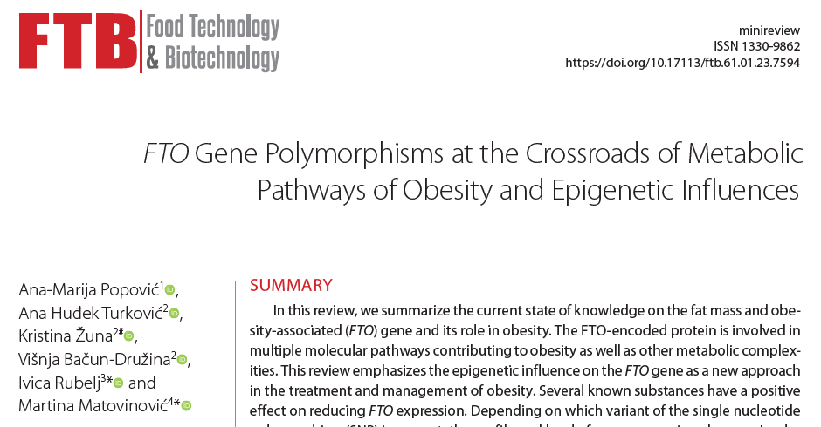

Slide 28
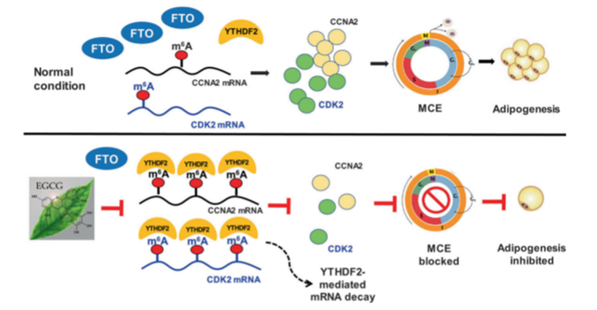
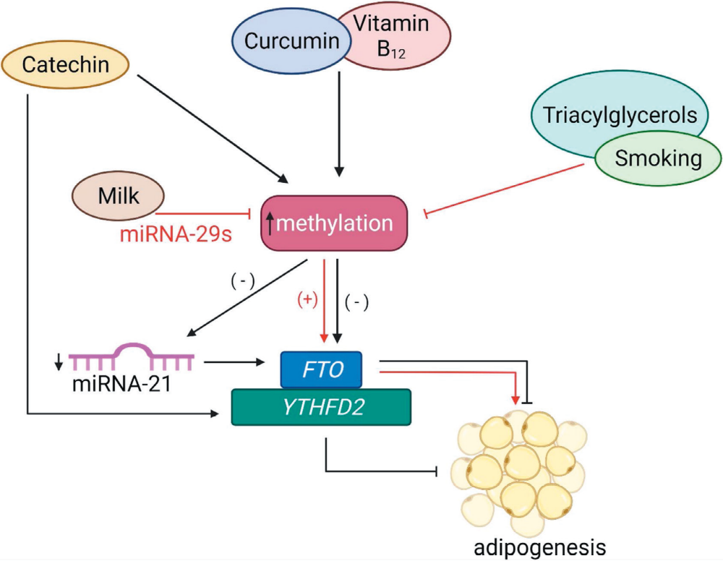
Epigenetic regulation via the FTO gene
vitamin B12, curcumin or green tea increase methylation of the FTO gene and block adipogenesis
milk, triacylglycerols and smoking inhibit methylation and thereby increase the FTO expression, causing adipogenesis.
Catechin also increases YTHFD2 activity, which is m6A reader, therefore YTHDF2 activity increases methylation levels of the FTO gene and blocks adipogenesis
Notes:
Broj obroka u danu je veći od dva u 90% kontrole i 45,5% pretilih, ali to nije statistički značajno (p = 0,0532). Ne doručkuje 15,9% pretilih dok svi u kontrolnoj skupini doručkuju redovito ili neredovito, ali to ipak nije statistički značajno (p = 0,0882). Više pretilih je svoju prehranu ocijenilo kao bogatu slatkišima i grickalicama (p =0,0133 ) i bogatu mesom i mesnim prerađevinama (p =0,006).

Slide 29
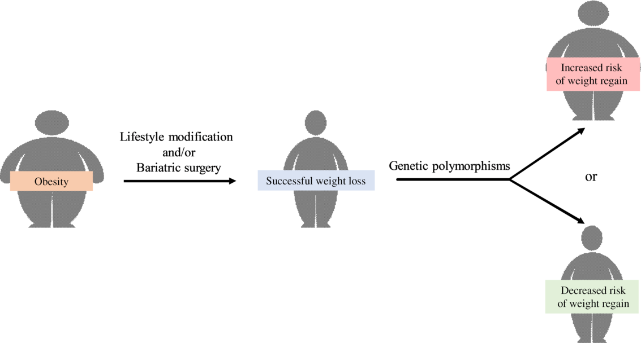
The impact of genetic polymorphisms on weight regain after successful weight loss
Thonusin C et al. The impact of genetic polymorphisms on weight regain after successful weight loss. British Journal of Nutrition. 2020;124(8):809-823.
Notes:
Thonusin C, Shinlapawittayatorn K, Chattipakorn SC, Chattipakorn N. The impact of genetic polymorphisms on weight regain after successful weight loss. British Journal of Nutrition. 2020;124(8):809-823. doi:10.1017/S0007114520001968

Slide 30


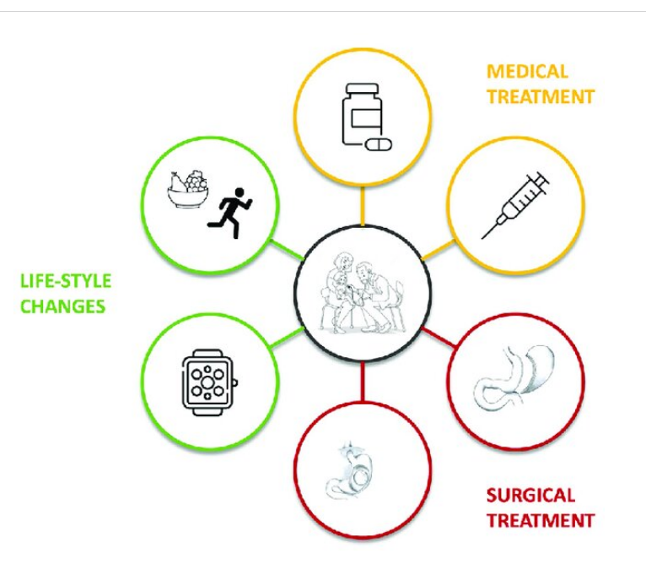
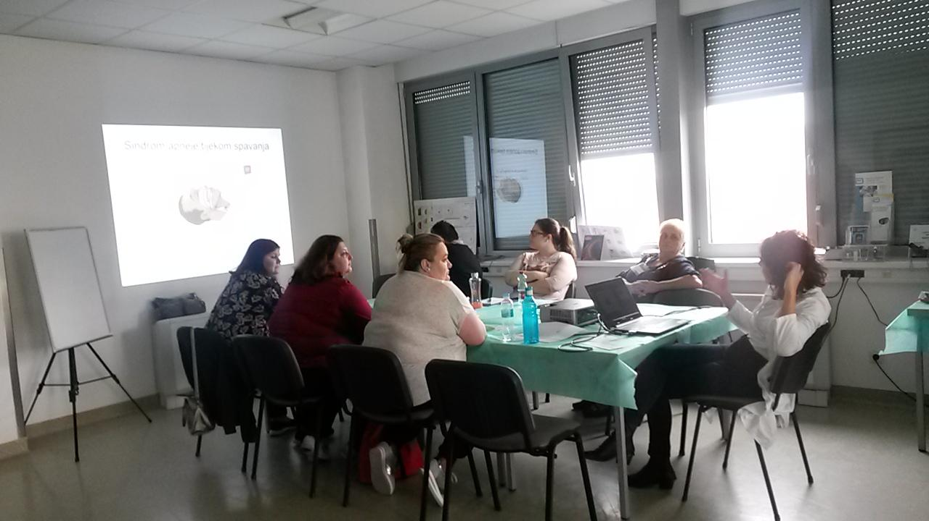
Education...individual approach
Notes:
kvaliteta rada u grupi ovisi o stručnosti i zalaganju svih članova tima te naravno i o sastavu grupe
nije nužno da bolesnici budu apsolutno slični po godinama starosti i trajanju bolesti ili po intelektualnim sposobnostima
izuzetno je ljekovito što mogu razmijenjivati iskustva i dati podršku jedni drugima

Slide 31
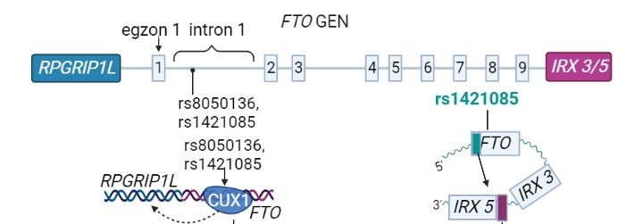
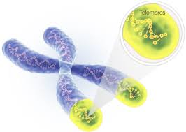
Research continues...
determination of 3 more FTO gene polymorphisms in women with obesity and the control group... rs8050136, rs9930506 i rs1121980
determination of telomere length in women with obesity and the control group...

Slide 32

Thank you for your attention...

